Slide 1
Social Distancing Detector
Ori Zur
Northwestern University ‘22
August 10, 2020

Slide 2
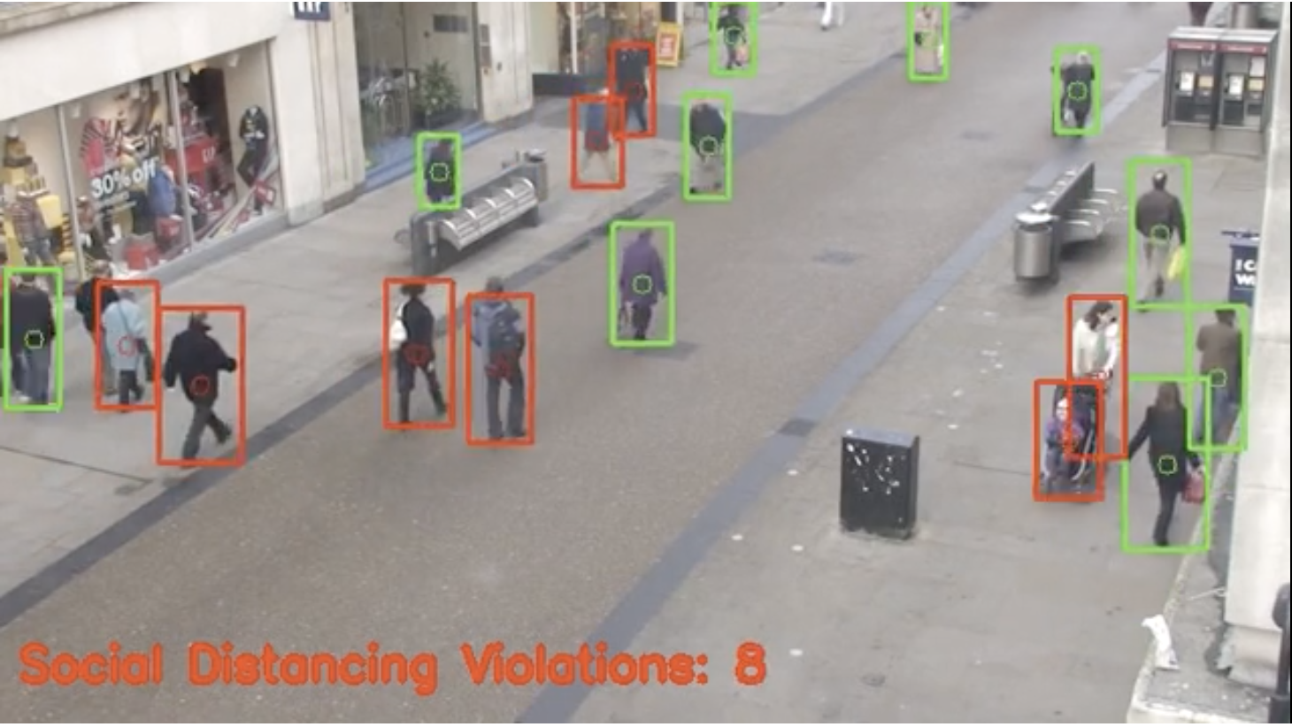
Social Distancing Detector
Detects, tracks, and calculates distances between people
Indicates if distance is less than six feet

Slide 3

Sage
Array of weather and urban sensors
Utilizes “AI at the Edge”
Goal: turn my project into Sage plug-in
https://sagecontinuum.org/

Slide 4
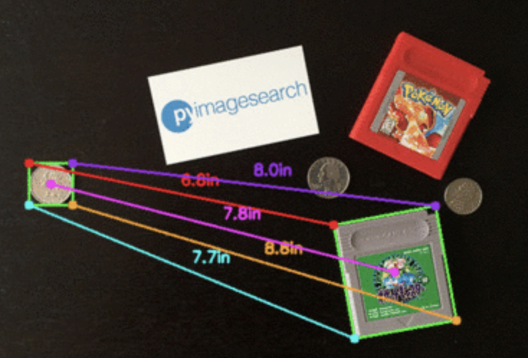
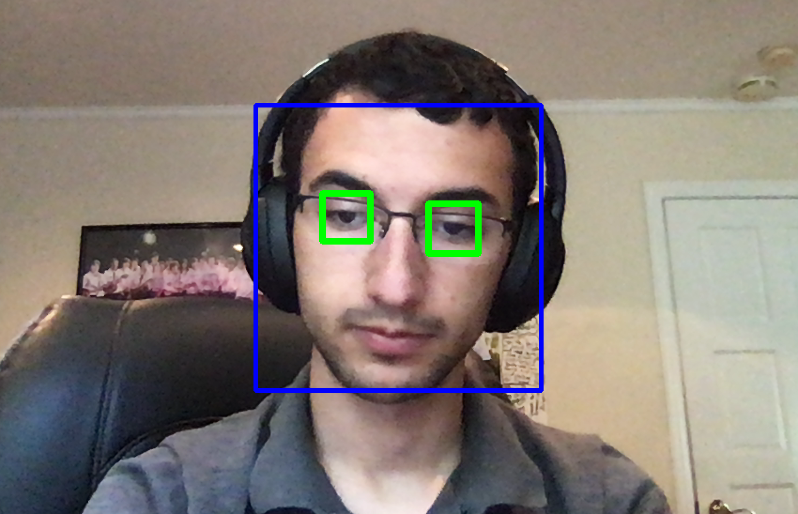
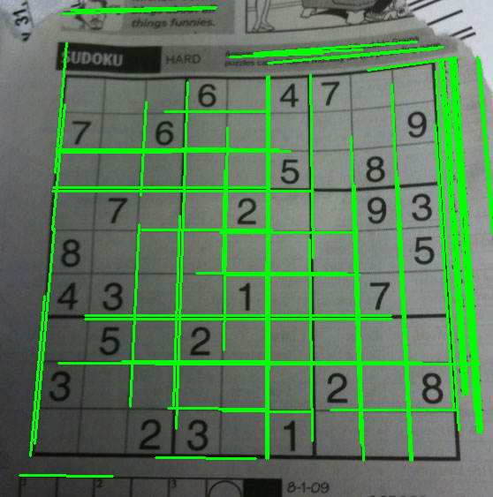
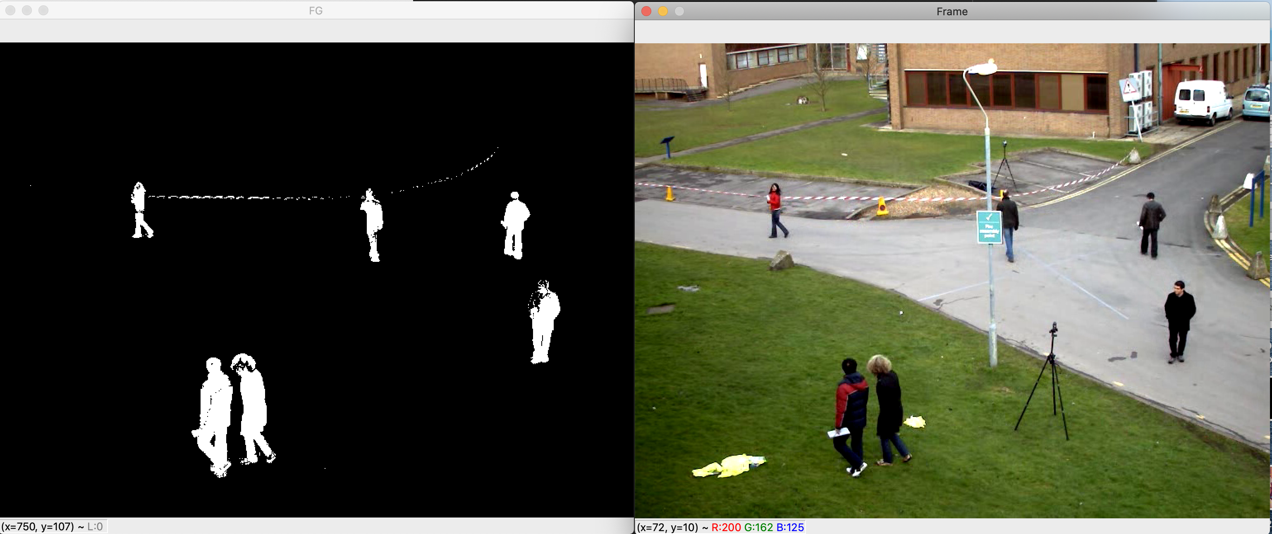
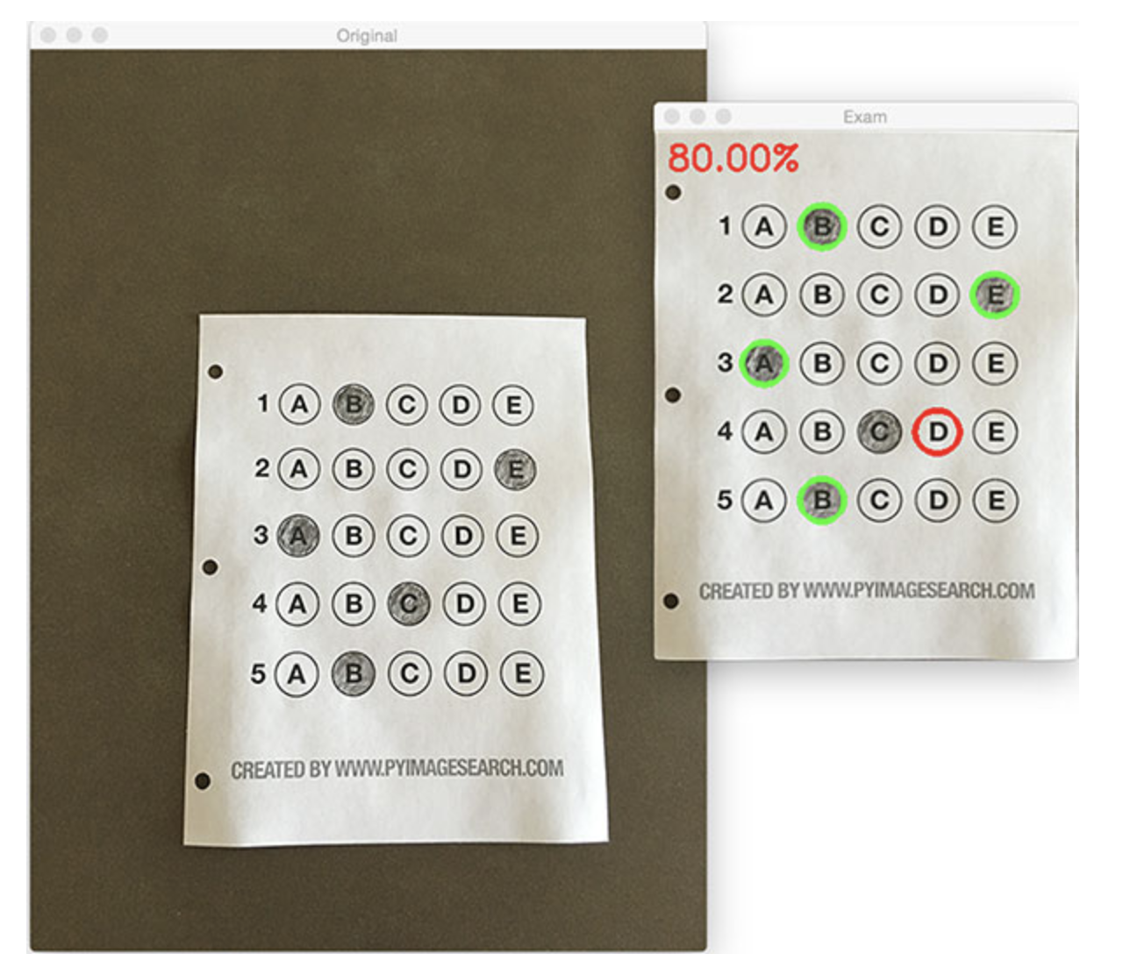
OpenCV: Functions Library for Computer Vision

Slide 5
Social Distancing Detector Overview
Step 1: Person detection
Step 2: Image transformation
Step 3: Coordinate mapping and distance calculations

Slide 6
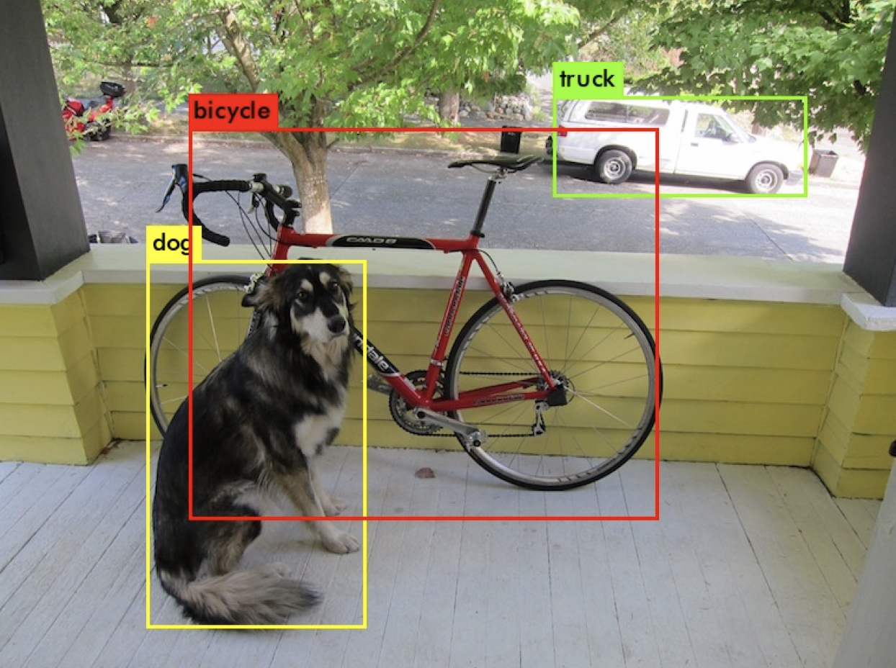
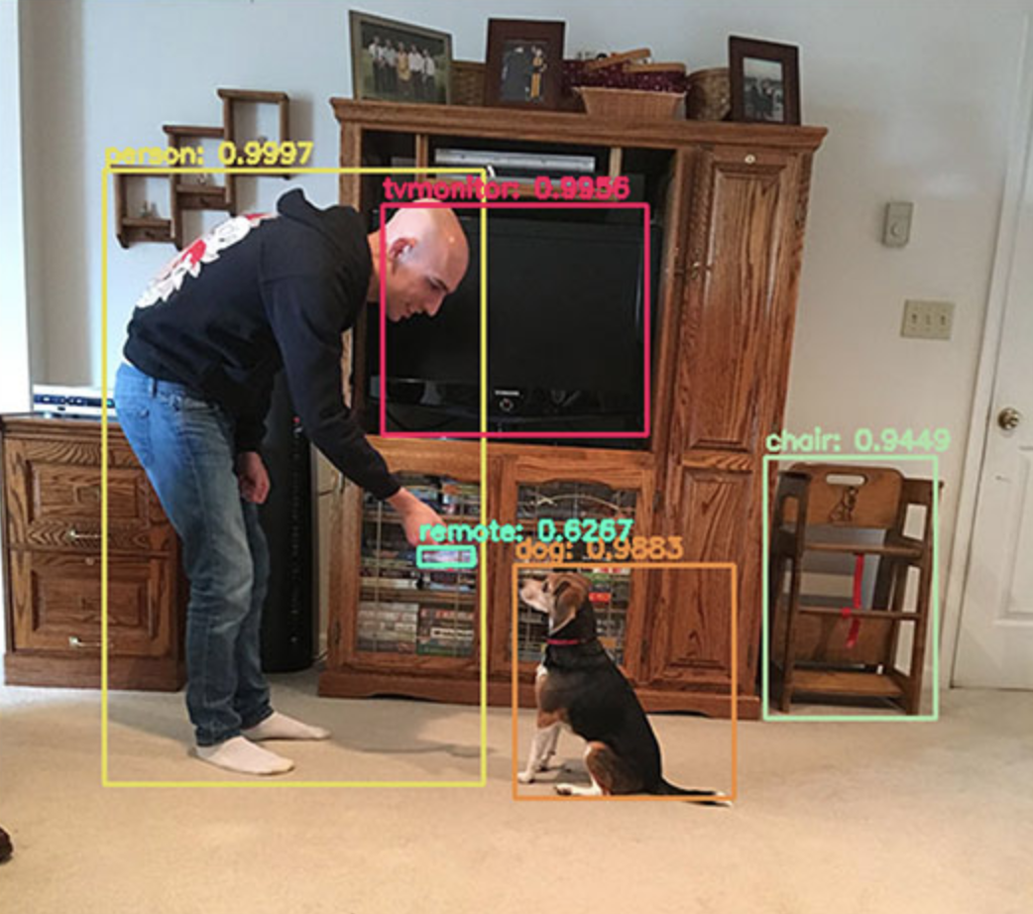
Step 1 – Person Detection (YOLOv3)

Slide 7
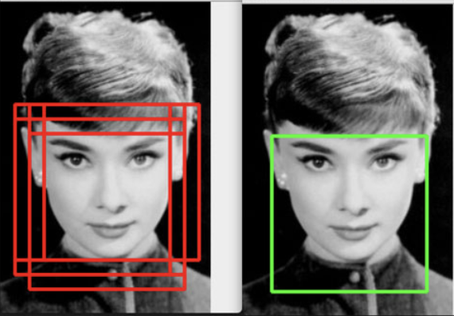
Non-Maximum Suppression Algorithm

Slide 8
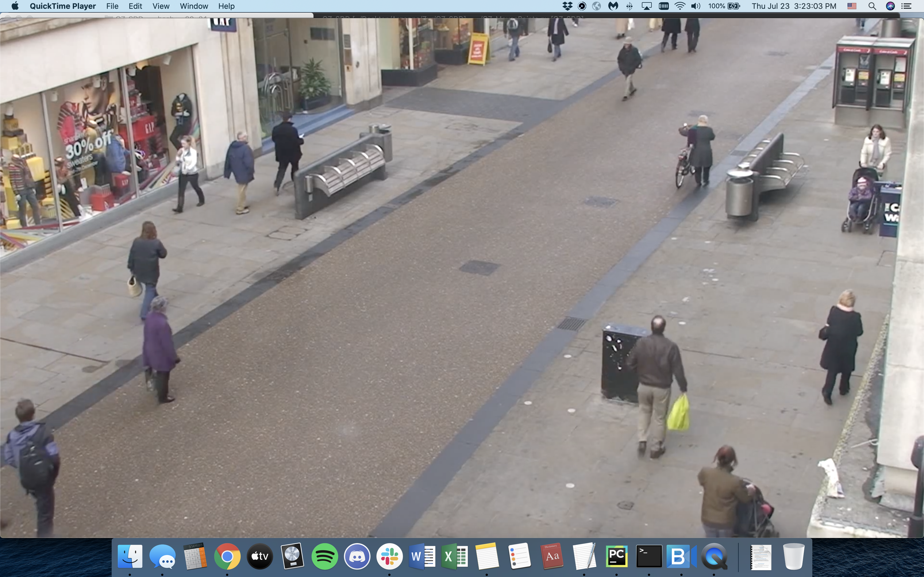
Step 2 – Image Transformation

Slide 9
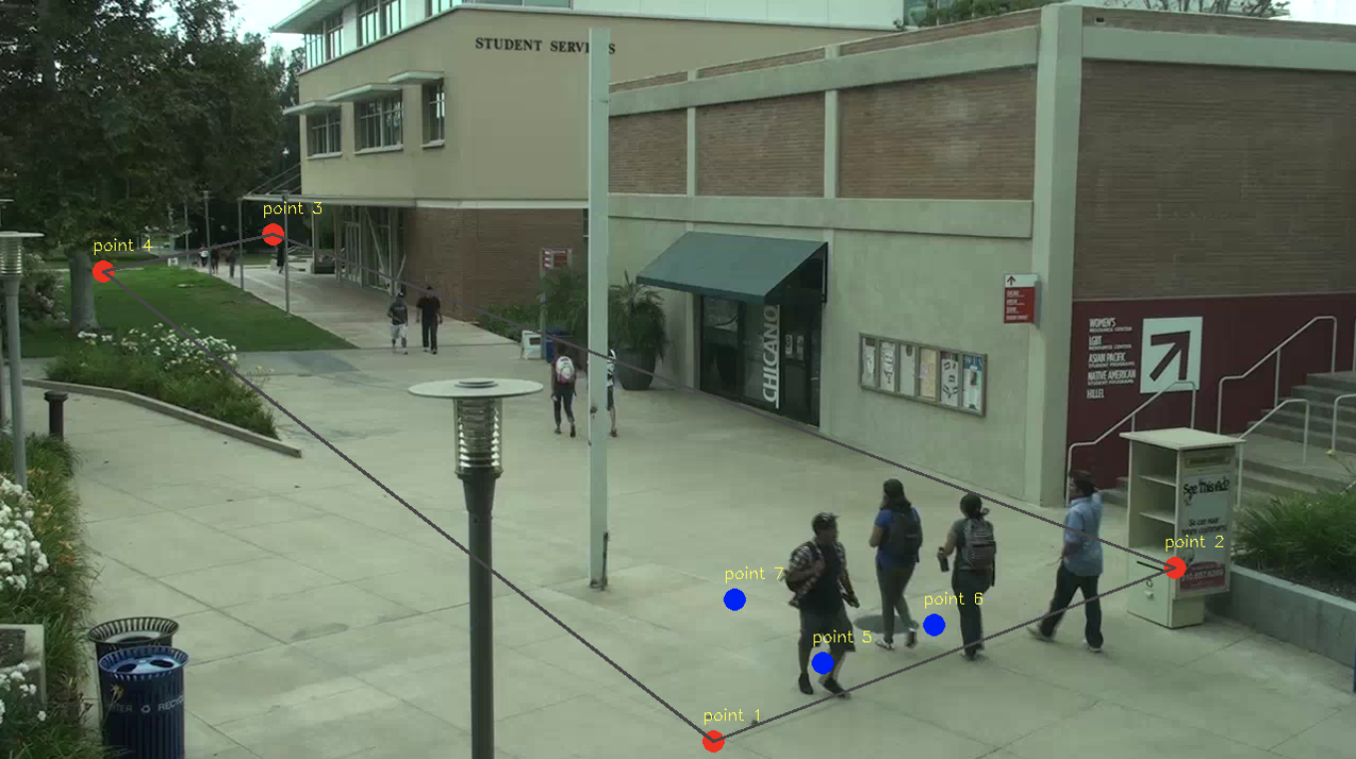
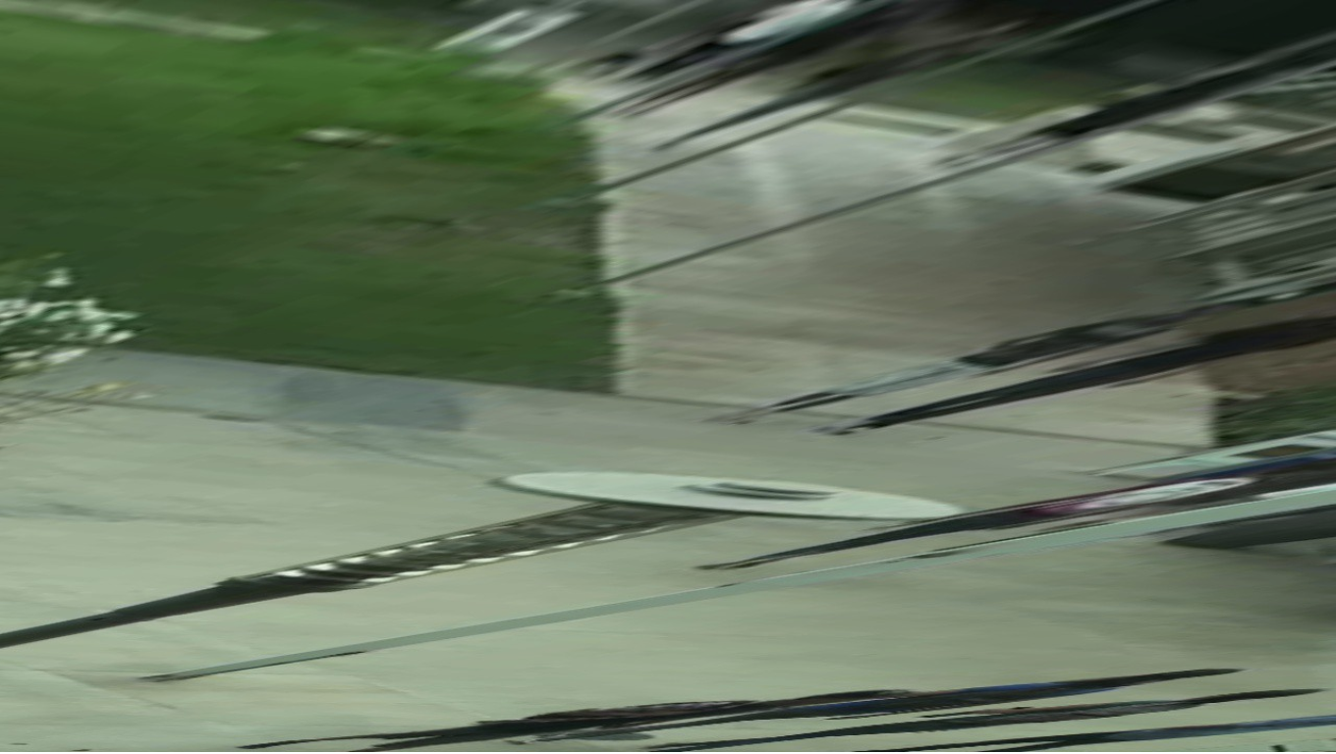
User Provides Region of Interest

Slide 10
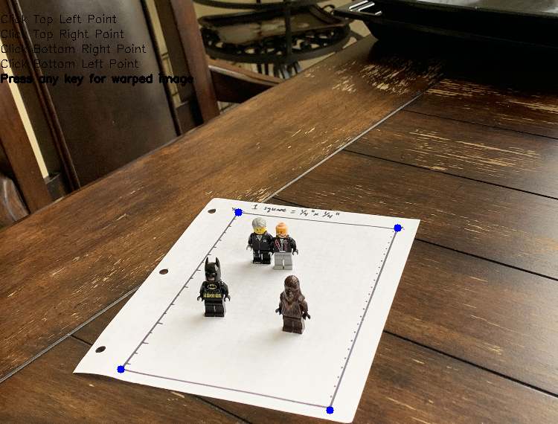
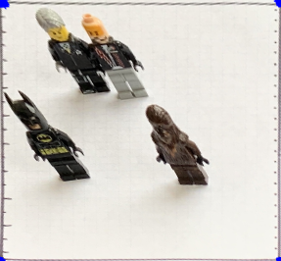
Small Scale Lego Test

Slide 11
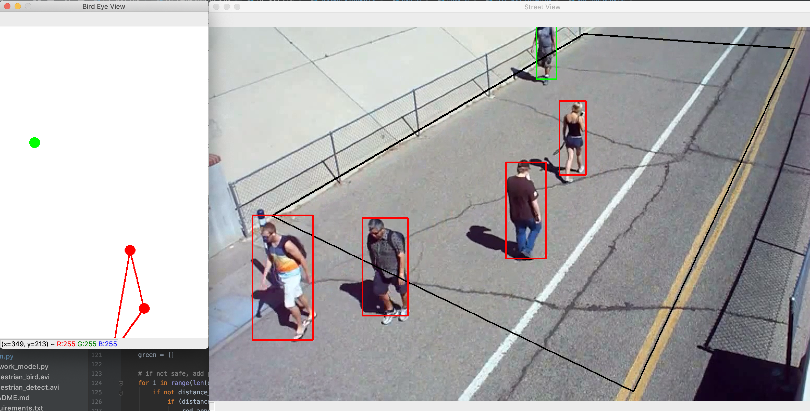
Step 3 – Coordinate Mapping and Distance Calculations

Slide 12
Future Improvement: Groups

Slide 13
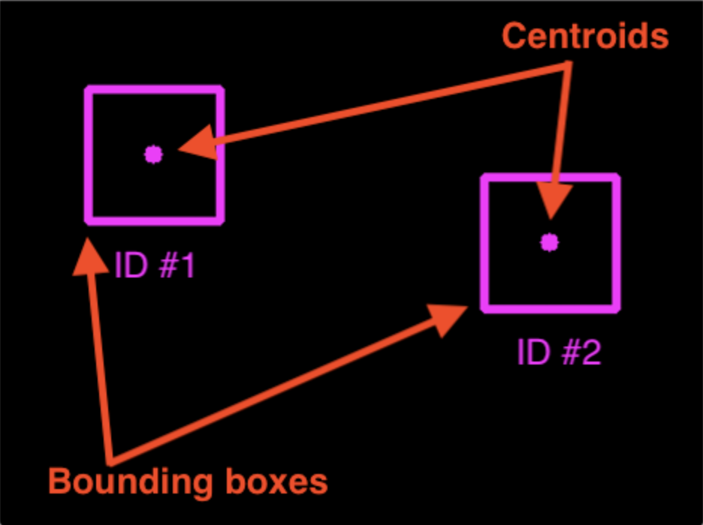
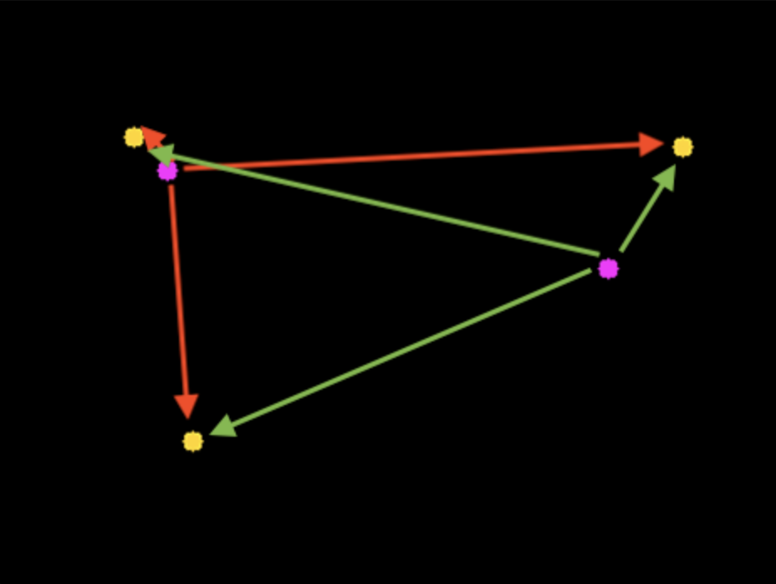
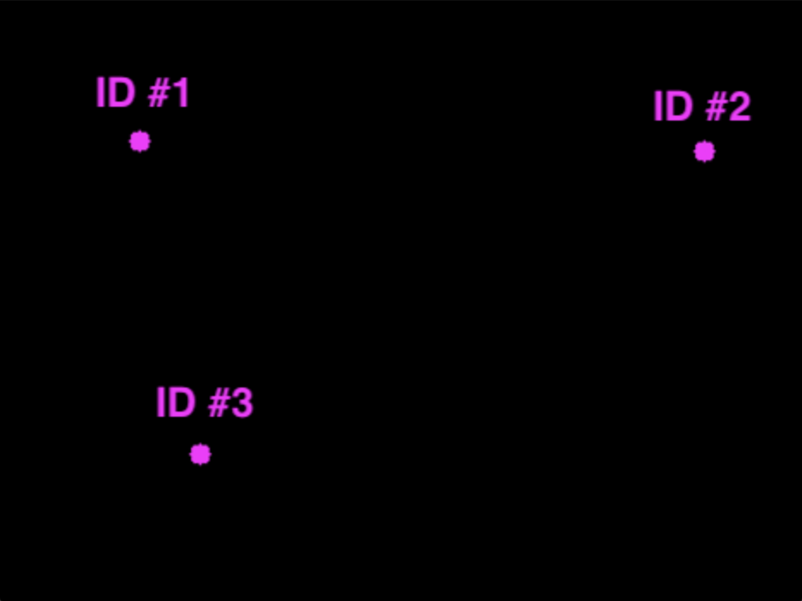
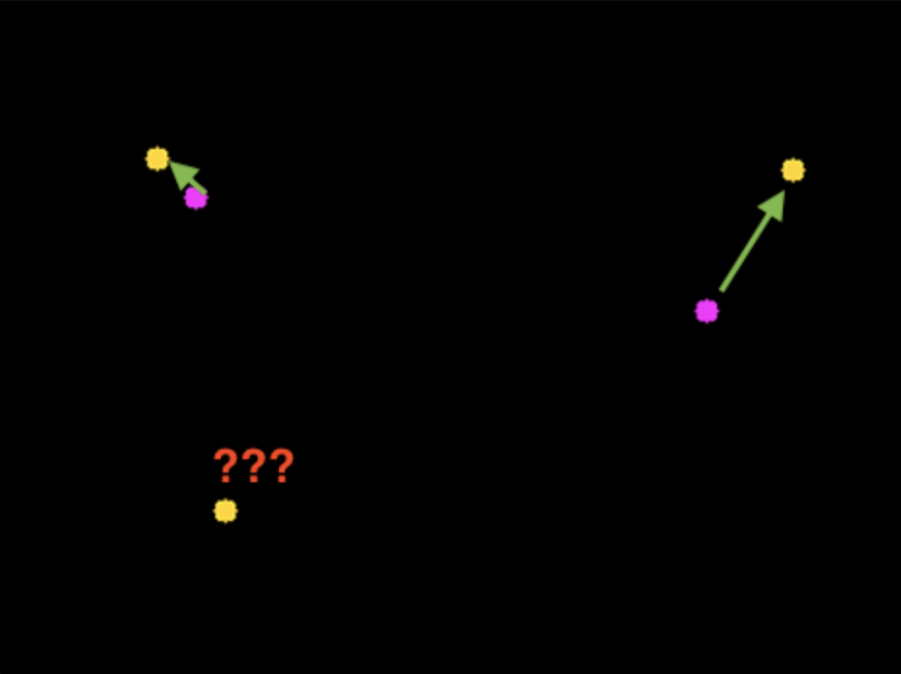
Centroid Tracking Algorithm

Slide 14
Other Future Improvements
Improve accuracy by reducing human error
Ability to change minimum safe distance
Multiple levels of risk (6 feet, 10 feet, etc.)

Slide 15
Other Applications for Human Proximity Detection
Museums
Crosswalks
Crowd Size Estimation

Slide 16

Acknowledgements
Dr. Nicola Ferrier
Dr. Scott Collis
Dr. Pete Beckman
Dr. Rajesh Sankaran
Sage Team, fellow interns
Dr. Jennifer Dunn, NAISE Team
Fellow NAISE Interns

Slide 17
Thank You
Questions?

